Slide 1
Clustering
Sanjay Ranka
Distinguished Professor
Department of Computer and Information Science and Engineering
www.sanjayranka.com
sanjayranka@gmail.com
352 514 4213

Slide 2
Hierarchical Clustering
Two main types:
Agglomerative
Start with the points as individual clusters
Merge clusters until only one is left
Divisive
Start with all the points as one cluster
Split clusters until only singleton clusters remain
Agglomerative is more popular
Traditional hierarchical algorithms use a similarity or distance matrix.
Merge or split one cluster at a time

Slide 3
Hierarchical Clustering
Produces a set of nested clusters organized as a hierarchical tree.
Can be visualized as a dendrogram
Tree like diagram
Records the sequences of merges or splits
Can ‘cut’ the dendrogram to get a partitional clustering

Slide 4
Basic Agglomerative Clustering Algorithm
Algorithm is straightforward
Compute the proximity matrix, if necessary
Let each data point be a cluster
Repeat
Merge the two closest clusters
Update the proximity matrix
Until only a single cluster remains
Key operation is the computation of the proximity of two clusters.
Different approaches to defining the distance between clusters distinguishes the different algorithms.

Slide 5
Agglomerative Hierarchical Clustering:
For agglomerative hierarchical clustering we start with clusters of individual points and a proximity matrix.
p1
p2
p3
p4
p5
. . .
p1
p2
p3
p4
p5
.
.
.
Proximity Matrix

Slide 6
Agglomerative Hierarchical Clustering: Intermediate Situation
After some merging steps, we have some clusters.
C1
C2
C3
C4
C5
C1
C3
C2
C4
C3
C4
C1
C5
C2
C5
Proximity Matrix

Slide 7
Agglomerative Hierarchical Clustering: Intermediate Situation
We want to merge the two closest clusters (C2 and C5) and update the proximity matrix.
C1
C2
C3
C4
C5
C1
C3
C2
C4
C3
C4
C1
C5
C2
C5
Proximity Matrix

Slide 8
Agglomerative Hierarchical Clustering: After Merging
The question is “How do we update the proximity matrix?”
C2 U C5
C1
C3
C4
C1
?
C3
? ? ? ?
C2 U C5
C4
C3
?
C4
?
C1
Proximity Matrix
C2 U C5

Slide 9
How to Define Inter-Cluster Similarity
p1
p2
p3
p4
p5
. . .
p1
Similarity?
p2
p3
p4
MIN
MAX
Group Average
Distance Between Centroids
Other methods driven by an objective function
Ward’s Method uses squared error
p5
.
.
.
Proximity Matrix

Slide 10
How to Define Inter-Cluster Similarity
p1
p2
p3
p4
p5
. . .
p1
p2
p3
p4
MIN
MAX
Group Average
Distance Between Centroids
Other methods driven by an objective function
Ward’s Method uses squared error
p5
.
.
.
Proximity Matrix

Slide 11
How to Define Inter-Cluster Similarity
p1
p2
p3
p4
p5
. . .
p1
p2
p3
p4
MIN
MAX
Group Average
Distance Between Centroids
Other methods driven by an objective function
Ward’s Method uses squared error
p5
.
.
.
Proximity Matrix

Slide 12
How to Define Inter-Cluster Similarity
p1
p2
p3
p4
p5
. . .
p1
p2
p3
p4
MIN
MAX
Group Average
Distance Between Centroids
Other methods driven by an objective function
Ward’s Method uses squared error
p5
.
.
.
Proximity Matrix

Slide 13
Cluster Similarity: MIN or Single Link
Similarity of two clusters is based on the two closest points in the different clusters.
Determined by one pair of points, i.e., by one link in the proximity graph.
Can handle non-elliptical shapes.
Sensitive to noise and outliers.

Slide 14
Hierarchical Clustering: MIN
5
1
3
5
2
1
2
3
6
4
4
Nested Clusters
Dendrogram

Slide 15
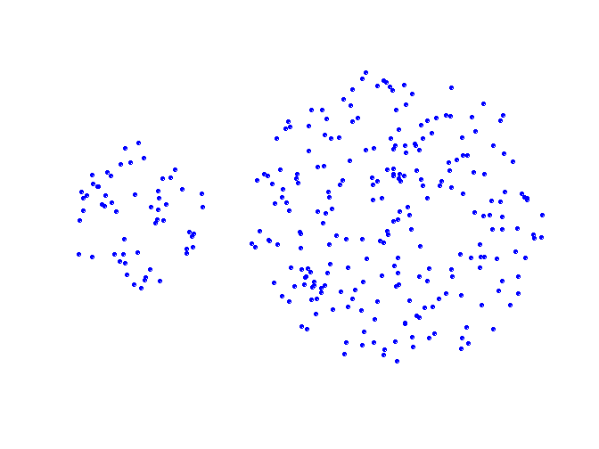
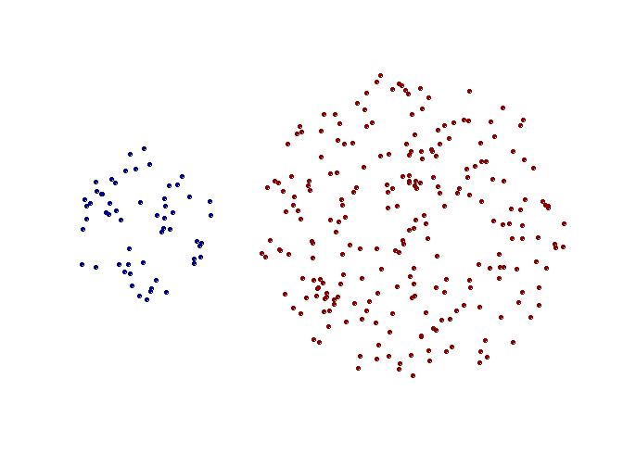
Strength of MIN
Original Points
Two Clusters

Slide 16
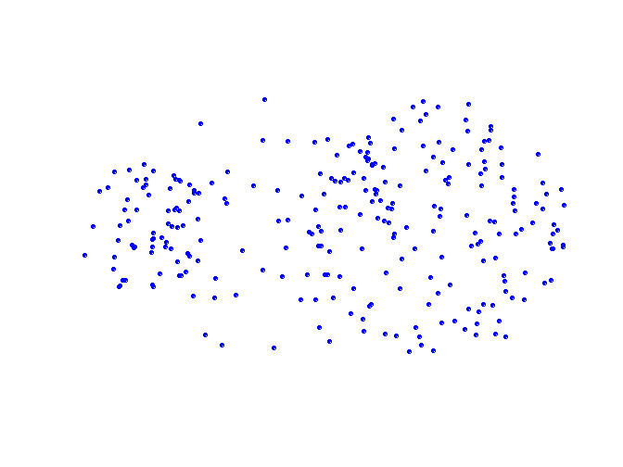
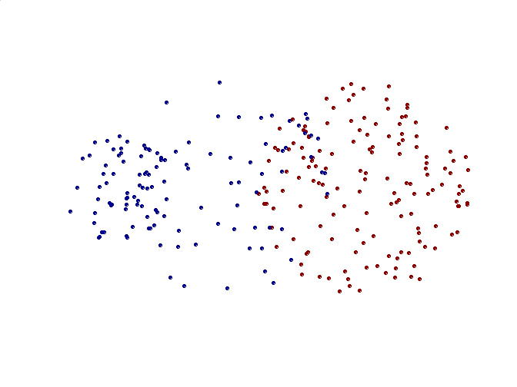
Limitations of MIN
Original Points
Two Clusters

Slide 17
Cluster Similarity: MAX or Complete Linkage
Similarity of two clusters is based on the two most distant points in the different clusters.
Determined by all pairs of points in the two clusters.
Tends to break large clusters.
Less susceptible to noise and outliers.
Biased towards globular clusters.

Slide 18
Hierarchical Clustering: MAX
4
1
2
5
5
2
3
6
3
1
4
Nested Clusters
Dendrogram

Slide 19
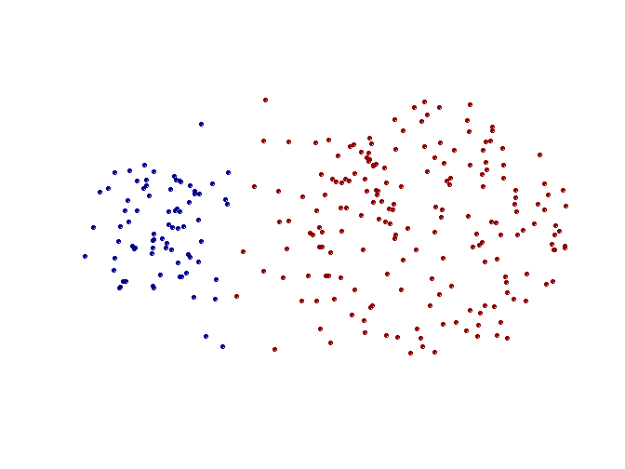
Strength of MAX
Original Points
Two Clusters

Slide 20
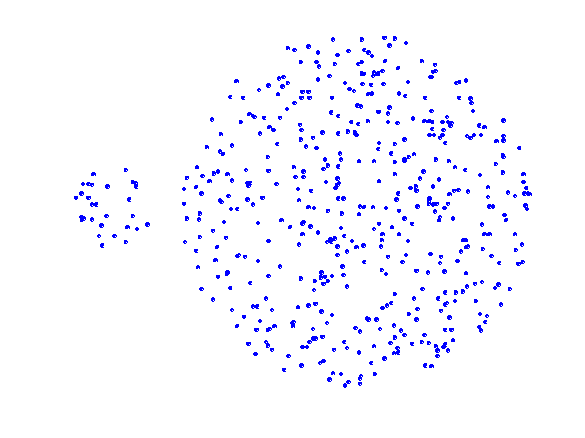
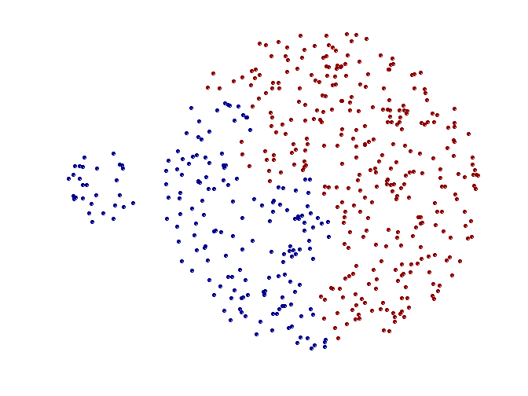
Limitations of MAX
Original Points
Two Clusters

Slide 21
Cluster Similarity: Group Average
Distance of two clusters is the average of pairwise distance between points in the two clusters.
Compromise between Single and Complete Link.
Need to use average connectivity for scalability since total connectivity favors large clusters.
Less susceptible to noise and outliers.
Biased towards globular clusters.

Slide 22
Hierarchical Clustering: Group Average
5
1
2
5
2
3
6
3
4
1
4
Nested Clusters
Dendrogram

Slide 23
Cluster Similarity: Ward’s Method
Similarity of two clusters is based on the increase in squared error when two clusters are merged.
Similar to group average if distance between points is distance squared.
Less susceptible to noise and outliers.
Biased towards globular clusters.
Hierarchical analogue of K-means
But Ward’s method does not correspond to a local minimum
Can be used to initialize K-means

Slide 24
Hierarchical Clustering: Ward’s method
5
4
1
2
5
2
3
6
1
4
3
Nested Clusters
Dendrogram

Slide 25
Hierarchical Clustering: Comparison
5
1
4
1
3
2
5
5
5
2
1
MIN
2
MAX
2
3
6
3
3
6
1
4
4
4
5
5
1
4
1
2
2
5
2
Ward’s Method
5
2
3
6
Group Average
3
3
6
4
1
1
4
4
3

Slide 26
Hierarchical Clustering: Time and Space requirements
O(N²) space since it uses the proximity matrix.
N is the number of points.
O(N³) time in many cases.
There are N steps and at each step the proximity matrix (size N²) must be updated and searched.
By being careful, the complexity can be reduced to O(N² log N ) time for some approaches.

Slide 27
Hierarchical Clustering: Problems and Limitations
Once a decision is made to combine two clusters, it cannot be undone.
No objective function is directly minimized.
Different schemes have problems with one or more of the following:
Sensitivity to noise and outliers.
Difficulty handling different sized clusters and convex shapes.
Breaking large clusters.

